Slide 1
Chapter 1
Thinking Like an Economist
© 2019 McGraw-Hill Education. All rights reserved. Authorized only for instructor use in the classroom. No reproduction or distribution without the prior written consent of McGraw-Hill Education.

Slide 2
Learning Objectives
Explain and apply the Scarcity Principle, which says that having more of any good thing necessarily requires having less of something else.
Explain and apply the Cost-Benefit Principle, which says that an action should be taken if, but only if, its benefit is at least as great as its cost.
Discuss three important pitfalls that occur when applying the Cost-Benefit Principle inconsistently.
Explain and apply the Incentive Principle, which says that if you want to predict people’s behavior, a good place to start is by examining their incentives.

Slide 3
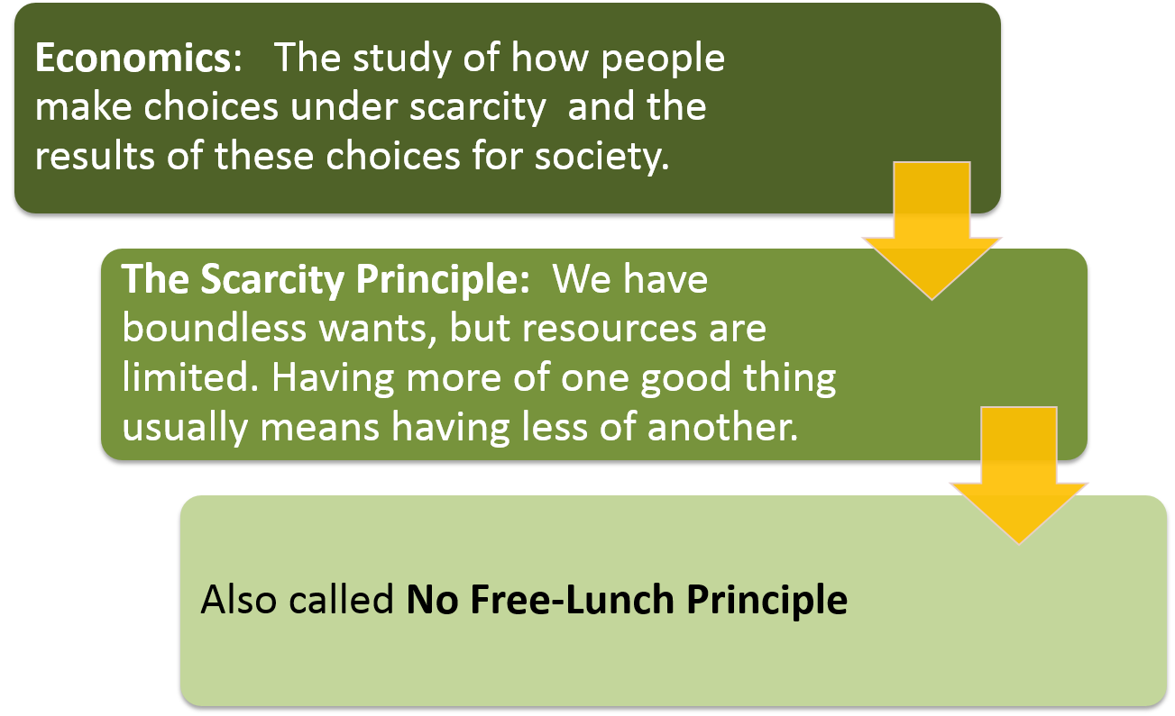
The Scarcity Principle

Slide 4
The Scarcity Principle: Examples
Scarcity is involved in
Global warming | Political elections | Career choices | Buying bottled water

Slide 5

The Cost-Benefit Principle
Take an action if and only if the extra benefits are at least as great as the extra costs
Costs and benefits are not just money

Slide 6
Applying the Cost-Benefit Principle
Assume people are rational
A rational person has well defined goals and tries to fulfill those goals as best they can
Would you walk to town to save $10 on an item?
Benefits are clear ($10)
But what are the “costs of walking to town”?
Hypothetical auction
Would you walk to town if the savings were $1000?
How about savings of $500? $100? $50?
If you would walk to town for savings of $9, but not for savings of $8.99, then your costs of walking must be $9!

Slide 7
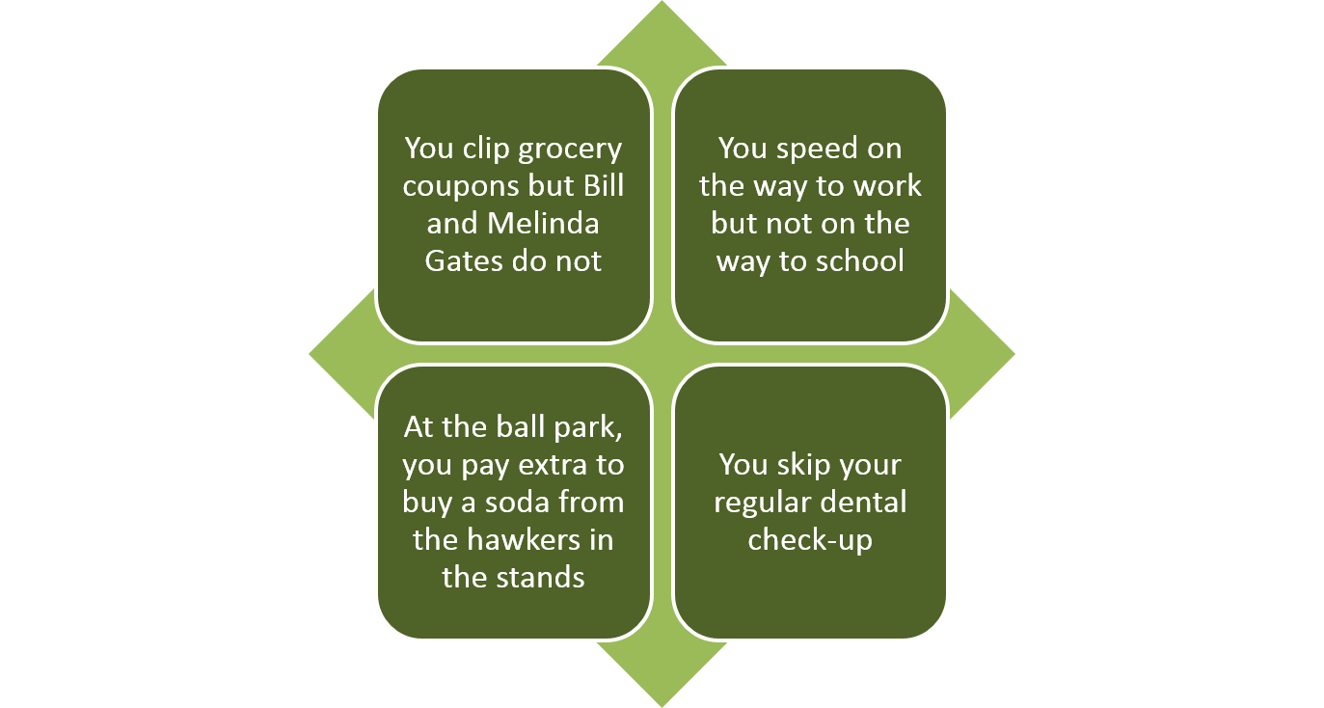
Cost – Benefit Principle Examples

Slide 8
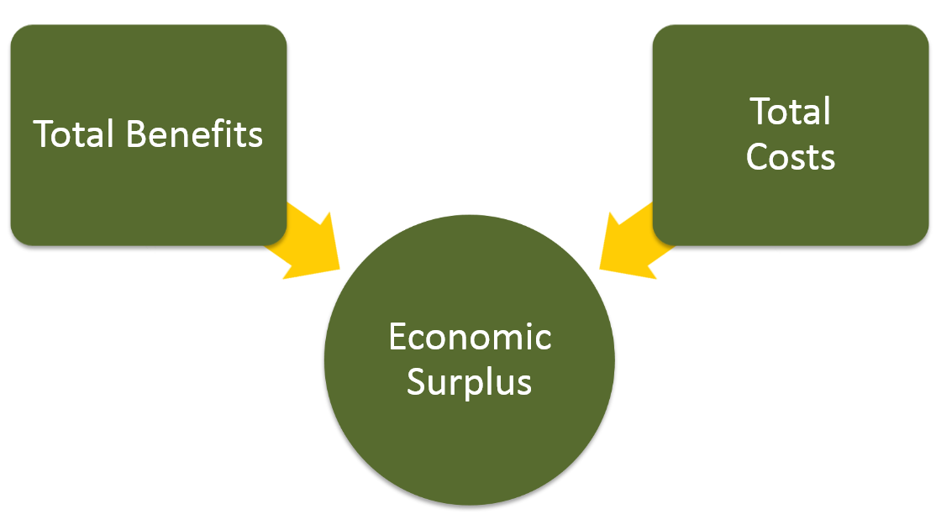
Economic Surplus 1
The economic surplus of an action is equal to its benefit minus its costs

Slide 9
Economic Surplus 2
The economic surplus of an action is equal to its benefit minus its costs
Economic surplus = Total Benefits − Total Costs
If we get $10 of savings from walking to town, and our costs of walking to town are $9, then the economic surplus from walking to town is $10 − $9 = $1.

Slide 10
Opportunity Cost
Opportunity cost is the value of what must be foregone in order to undertake an activity
Consider explicit and implicit costs
Examples:
Give up an hour of babysitting to go to the movies
Give up watching TV to walk to town
Caution: NOT the combined value of all possible activities
Opportunity cost considers only your best alternative

Slide 11
Economic Models
Simplifying assumptions
Which aspects of the decision are absolutely essential?
Which aspects are irrelevant?
Abstract representation of key relationships
The Cost-Benefit Principle is a model
If costs of an action increase, the action is less likely
If benefits of an action increase, the action is more likely

Slide 12
Three Decision Pitfalls
Economic analysis predicts likely behavior
Three general cases of mistakes
Measuring costs and benefits as proportions instead of absolute amounts
Ignoring implicit costs
Failure to think at the margin

Slide 13
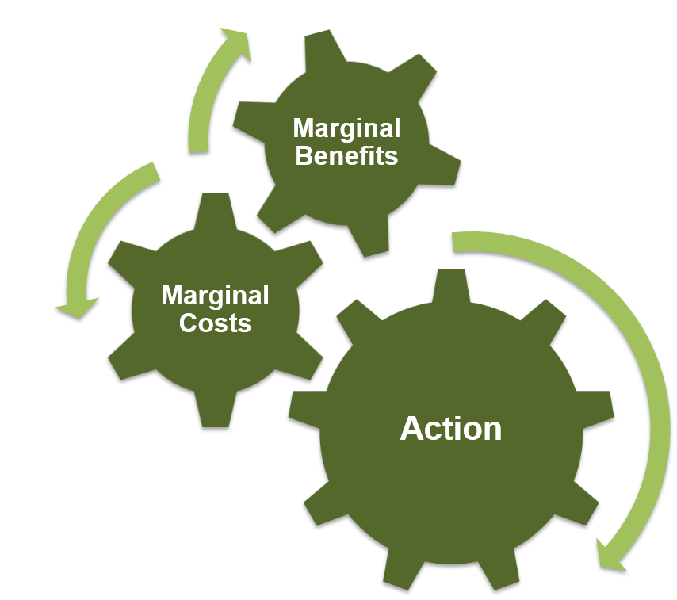
Pitfall 1
Measuring costs and benefits as proportions instead of absolute amount
Would you walk to town to save $10 on a $25 item?
Would you walk to town to save $10 on a $2,500 item?

Slide 14
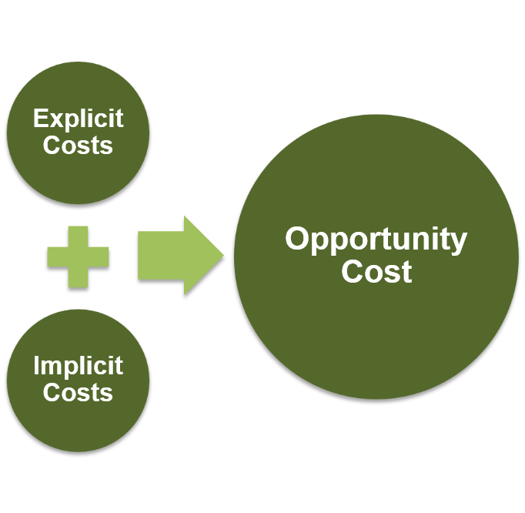
Pitfall 2
Ignoring implicit costs
Consider your alternatives
If you win a free concert ticket, it isn’t really “free”
What else would you have done with your evening?
Does going to the concert make you give up some other great activity?

Slide 15
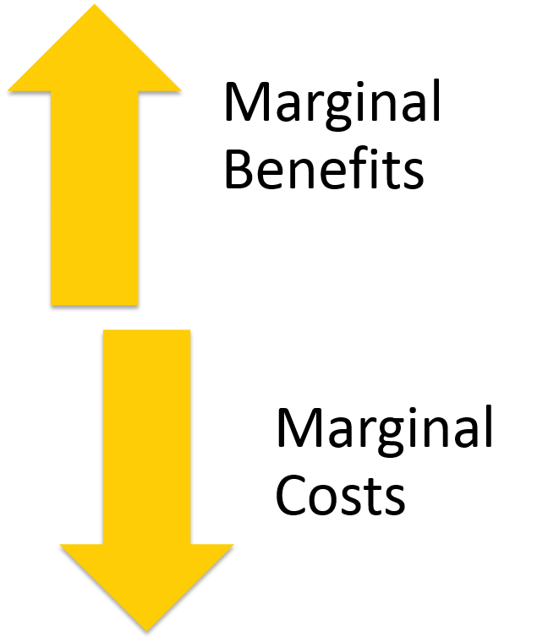
Pitfall 3
Failure to think at the margin
Sunk costs cannot be recovered
Examples:
Eating at an all-you-can-eat restaurant
Attend a second year of law school

Slide 16
Marginal Analysis Ideas
Marginal cost is the increase in total cost from one additional unit of an activity
Average cost is total cost divided by the number of units
Marginal benefit is the increase in total benefit from one additional unit of an activity
Average benefit is total benefit divided by the number of units

Slide 17
Marginal Analysis: SpaceX Rocket
# of Launches | Total Cost ($B) | Average Cost ($B/launch) | Marginal Cost ($B)
0 | $0 | $0 | $3
1 | $3 | $3 | $4
2 | $7 | $3.5 | $5
3 | $12 | $4 | $8
4 | $20 | $5 | $12
5 | $32 | $6.4
If the marginal benefit is $6 billion per launch, how many launches should SpaceX make?

Slide 18
Normative and Positive Economics
Normative economic principle says how people should behave
People shouldn’t pollute so much
SpaceX should launch as many rockets as possible
Positive economic principle predicts how people will behave
People will pollute less if you tax pollution
SpaceX will choose to launch rockets that it thinks it will turn a profit on

Slide 19
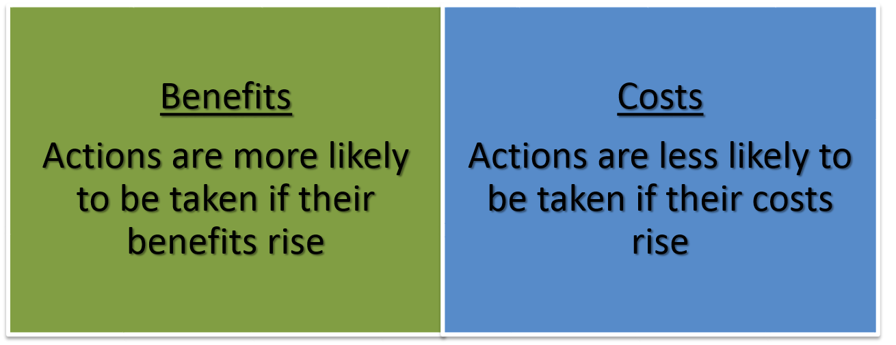
Incentive Principle
Incentives are central to people's choices

Slide 20
Microeconomics and Macroeconomics
Microeconomics studies choice and its implications for price and quantity in individual markets
Sugar
Carpets
House cleaning services
Microeconomics considers topics such as
Costs of production
Demand for a product
Exchange rates
Macroeconomics studies the performance of national economies and the policies that governments use to try to improve that performance
Inflation
Unemployment
Growth
Macroeconomics considers
Monetary policy
Deficits
Tax

Slide 21
Economics Is Choosing
Focus in this course is on a short list of powerful ideas
Explain many economic issues
Predict decisions made in a variety of circumstances
Core Principles are the foundation for solving economic problems

Slide 22
Economics Is Everywhere
There are many things that economics can help to explain
Economic Naturalist topics
Why is expensive software bundled with PCs?
Why can't you buy a car without heaters
Drive-up ATMs with Braille

Slide 23
Chapter 1 Appendix
Working with Equations,
Graphs, and Tables

Slide 24
Definitions
Equation
Variable
Dependent variable
Independent variable
Parameter (constant)
Slope
Intercept

Slide 25
From Words to an Equation
Identify the variables
Calculate the parameters
Slope
Intercept
Write the equation
Example: Phone bill is $5 per month plus 10 cents per minute
B = 5 + 0.10 T

Slide 26
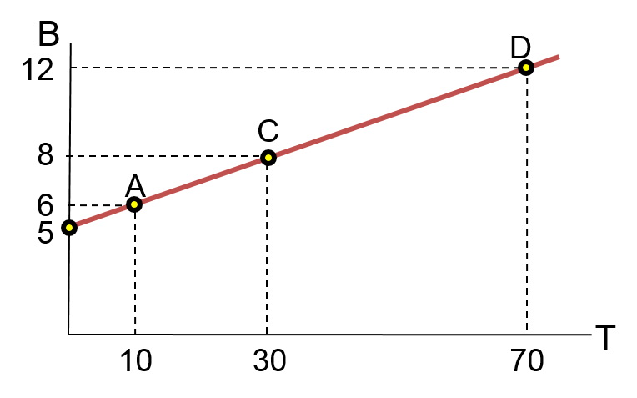
From Equation to Graph
B = 5 + 0.10 T
Draw and label axes
Horizontal is independent variable
Vertical is dependent variable
To graph,
Plot the intercept
Plot one other point
Connect the points

Slide 27
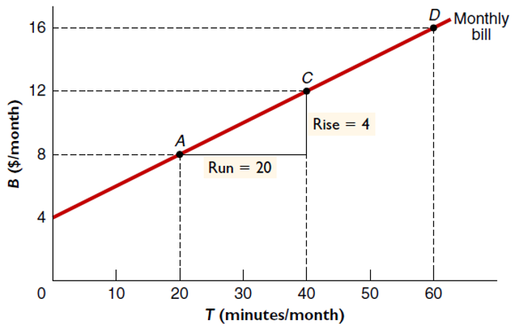
From Graph to Equation
Identify variables
Independent
Dependent
Identify parameters
Intercept
Slope
Write the equation
B = 4 + 0.2 T

Slide 28
Changes in the Intercept
An increase in the intercept shifts the curve up
Slope is unchanged
Caused by an increase in the monthly fee
A decrease in the intercept shifts the curve down
Slope is unchanged

Slide 29
Changes in the Slope
An increase in the slope makes the curve steeper
Intercept is unchanged
Caused by an increase in the per minute fee
A decrease in the slope makes the curve flatter
Intercept is unchanged

Slide 30
From Table to Graph
Long-distance bill ($/month) | Total long-distance calls (minutes/month)
$10.50 | 10
$11.00 | 20
$11.50 | 30
$12.00 | 40
Identify variables
Independent
Dependent
Label axes
Plot points
Connect points

Slide 31
From Table to Equation
Long-distance bill ($/month) | Total long-distance calls (minutes/month)
$10.50 | 10
$11.00 | 20
$11.50 | 30
$12.00 | 40
Identify independent and dependent variables
Calculate slope
Slope = (11.5 − 10.5) / (30 − 10) = 1/20 = 0.05
Solve for intercept, f, using any point
B = f + 0.05 T
12 = f + 0.05 (40) = f + 2
f = 12 − 2 = 10
B = 10 + 0.05 T

Slide 32
Simultaneous Equations 1
Two equations, two unknowns
Solving the equations gives the values of the variables where the two lines intersect
Lines intersect when the values of the independent and dependent variables are the same in the equations for both lines
Example
Two billing plans for phone service
How many minutes make the two plans cost the same?

Slide 33
Simultaneous Equations 2
Plan 1 B = 10 + 0.04T
Plan 2 B = 20 + 0.02T
Plan 1 has higher per minute price while
Plan 2 has a higher monthly fee
Find B and T for point A

Slide 34
Simultaneous Equations 3
Plan 1 B = 10 + 0.04 T
Plan 2 B = 20 + 0.02 T
Subtract Plan 2 equation from Plan 1 and solve for T
Find B when T = 500
B = 10 + 0.04 T
B = 10 + 0.04 (500)
B = $30
OR
B = 20 + 0.02 T
B = 20 + 0.02 (500)
B = $30

